Slide 1
Conformity Monkey

Slide 2

Outline
Introduction
Requirements for Conformity Monkey
Initial Design
Refactored Design from Simian Army Developers
Problems
How to use custom rules in Conformity Monkey
How to replace Auto Scaling Groups

Slide 3
Introduction
What is Conformity Monkey?
A service runs on AWS cloud.
Provide a conformity check.
Why use Conformity Monkey?
Check if the application or instances are launched on the conforming rules.
How Conformity Monkey works?
Mark and then Notify.

Slide 4
The Requirements for Conformity Monkey
Conformity Monkey determines whether an instance in clusters is nonconforming by applying a set of rules on it. If any of the rules determines that the instance is not conforming, the monkey marks the instance and sends an email notification to the owner of the cluster.
Cluster is the basic unit of conformity check. It includes a single ASG or a group of ASGs and an ASG includes one or many instances. Each cluster has an owner.
Cluster
ASG
ASG
instance
instance
instance
instance

Slide 5
The Requirements for Conformity Monkey (cont.)
Rule InstanceIsHealthyInEureka checks if all instances in the cluster are healthy in Discovery.
Rule InstanceHasHealthCheckUrl checks if all instances in a cluster has health check url in Discovery/Eureka.
Rule InstanceHasStatusUrl checks if all instances in a cluster has status url.
Rule InstanceInSecurityGroup checks whether or not all instances in a cluster are in specific security groups.
Rule InstanceTooOld checks if there are instances that are older than certain days. Instances are not considered to be permanent in the cloud, so sometimes having too old instances could indicate potential issues.
Rule SameZonesInElbAndAsg checks if the zones in ELB and ASG are the same.
Rule InstanceInVPC checks if an instance (a SoloInstance or an instance in ASG) is in a virtual private cloud.
Rule CrossZoneLoadBalancing checks if the cross-zone load balancing is enabled for all cluster ELBs (Elastic Load Balancer).

Slide 6
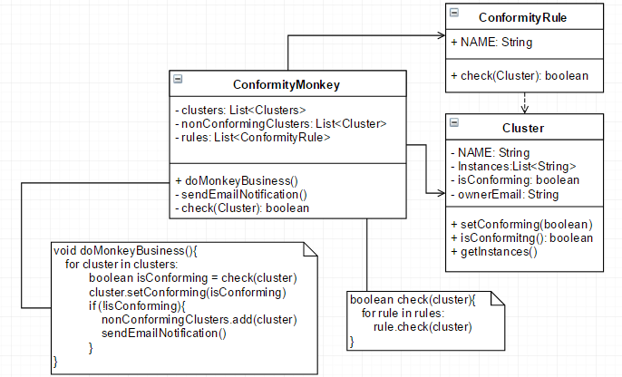
Requirement_1
Conformity Monkey determines whether an instance in clusters is nonconforming by applying a set of rules on it. If any of the rules determines that the instance is not conforming, the monkey marks the instance and sends an email notification to the owner of the cluster.
Notes:
check: loop the rules and check是否符合這些rules
doMonkeyBusiness: mark
sendEmailNotification: send notification to the owner of the cluster

Slide 7
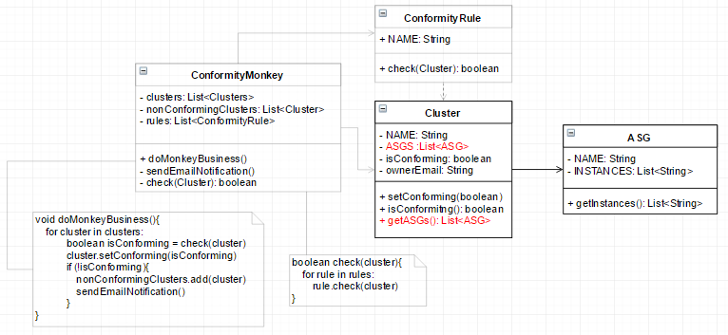
Requirement_2
Cluster is the basic unit of conformity check. It includes a single ASG or a group of ASGs and an ASG includes one or many instances. Each cluster has an owner.

Slide 8
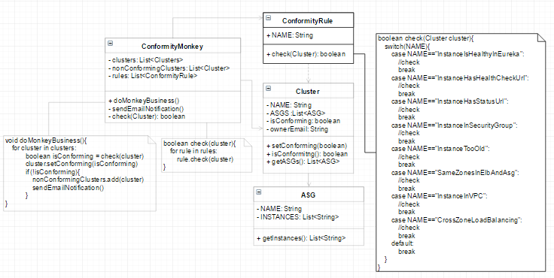
Requirement_3
Notes:
不同的rules有其不同的定義，根據rules的Name來分辨要進行何種conformity check

Slide 9
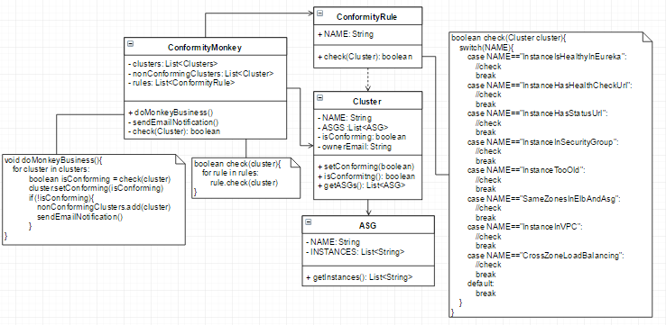
Initial Design
Violate
Dependency Inversion Principle
Violate
Single Responsibility Principle
&
Open/Closed Principle

Slide 10
Refactor
Each rule has their own check mechanism.
The design of Conformity Monkey has to make it simple to customize rules or to add new ones.
Single Responsibility Principle:
Separate out the rules from the rules processing logic.
Open/Closed Principle:
Add new rules without changing the rest of the system.
Dependency Inversion Principle:
Program to an interface, not an implementation.

Slide 11
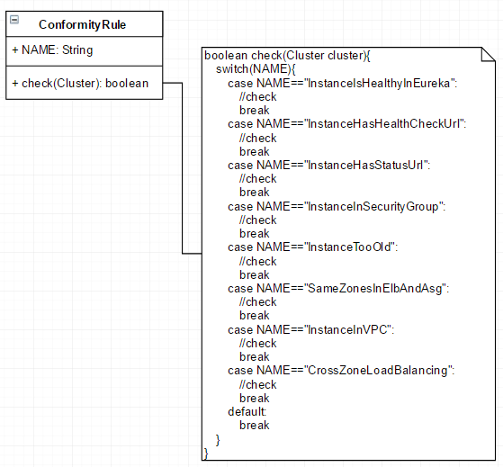
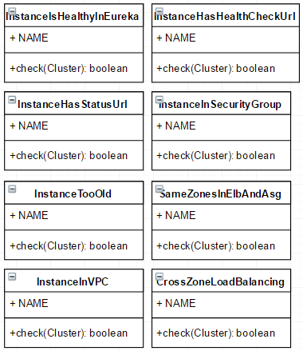
Act-1: Encapsulate what varies
Single Responsibility Principle:
Separate out the rules from the rules processing logic.

Slide 12
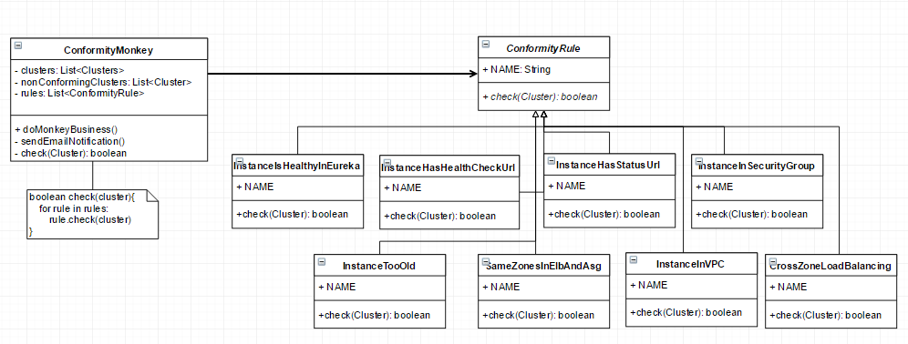
Act-2: Abstract Common Behaviors
Dependency Inversion Principle:
Program to an interface, not an implementation.
Open/Closed Principle:
Add new rules without changing the rest of the system.
Notes:
High module can’t depends on low module.
It should depends on abstraction or interface.

Slide 13
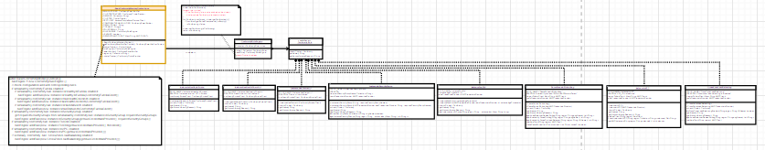
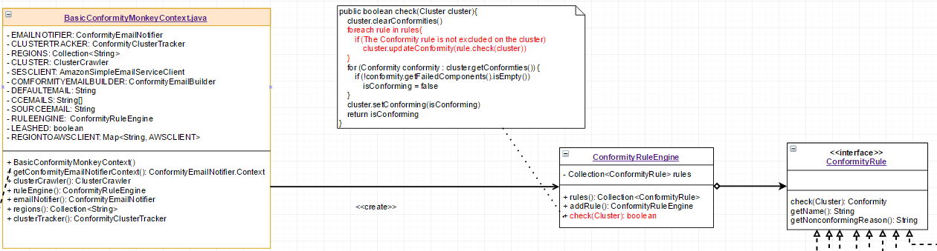
Act-3: Use a rule engine as an evaluator
client: ComformityMonkey
Single Responsibility Principle:
A class should have only one reason to change.

Slide 14
Advantage of using Rule Engine
Hide data and implementation detail from client.
If a rule has to be checked dynamically according to the current state, there will be a if-else chain in the client; it is difficult to manage the rules. With the rule engine, we can encapsulate the operations of the rules. Therefore, the client just interact with the rule engine to do conformity check.
Notes:
我們不需要知道rule engine是如何add rules、如何運作check conformity for all rules
如果今天有一些rules在判斷是否符合時，是需要去check目前的states，導致許多if-else chain出現在check function中，因此需要有rule engine來將複雜的implementation從client中抽出來，統一管理

Slide 15
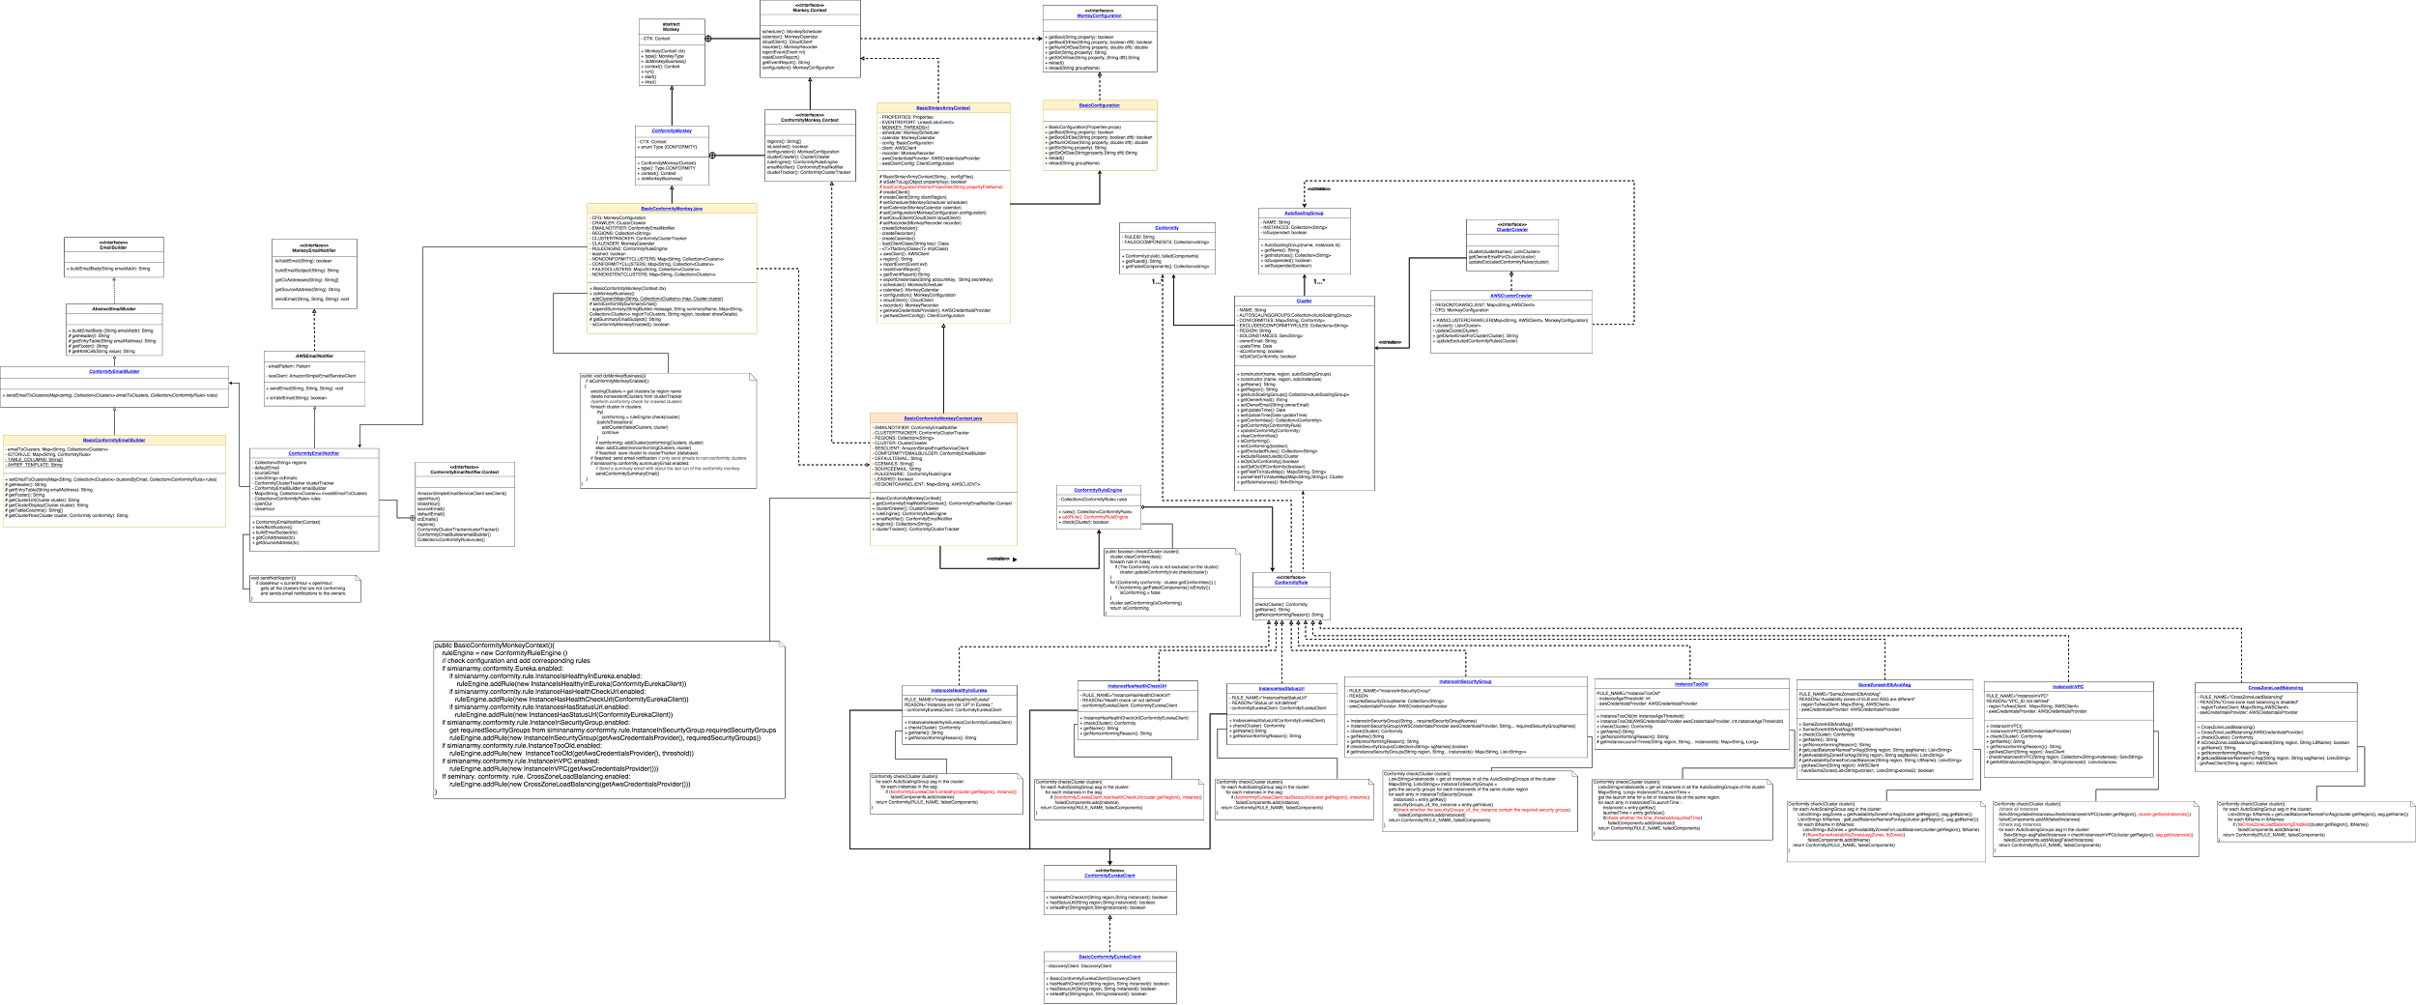
Final Class diagram of Conformity Monkey
Designed by Developers of SimianArmy
Monkey Client module
Monkey Configuration module
Cluster module
Rule module
Email module

Slide 16
Problem-1: How to create custom rules for Conformity Monkey
Create a concrete class that implements ConformityRule.
Add properties in conformity.properties to configure and enable/disable the new rule.
Modify client, BasicConformityMonkeyContext, to include the new rule in Monkey Runs.
Violate the Open/Closed Principle

Slide 17
A possible refactoring method

Slide 18
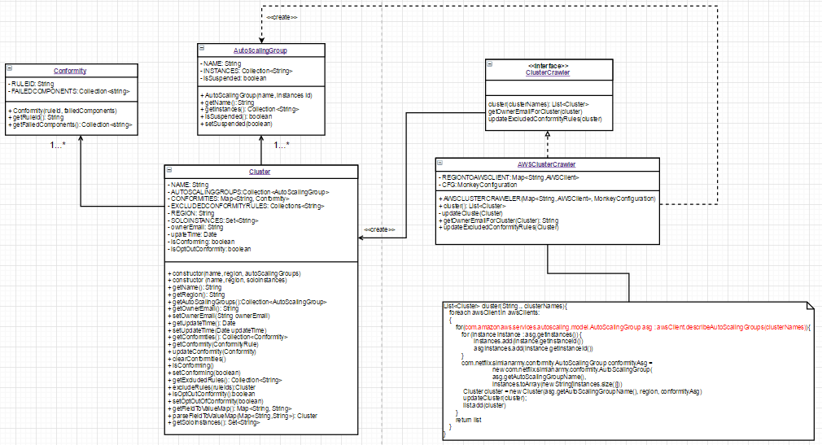
Problem-2: How to replace Auto Scaling Groups
(from: https://groups.google.com/forum/#!topic/simianarmy-users/4l1veoxU3NE)
Q: Replace ASG with a third-party tool to handle scaling of my EC2 instances .
A: They assume the structure of aws cluster which contains ASGs which contains instances. If you want, you can fork it and modify the iteration over instances to be in a way that doesn't use ASGs.
Violate the Open/Closed Principle !!!
Notes:
Instance: A single server or machine that is part of the group of machines subject to autoscaling.
Autoscaling group: The collection of instances subject to autoscaling, along with all the associated policies and state information

Slide 19
A possible refactoring method

